Slide 1

Linear Data Structures
CE1103 - Algorithms and Data Structures I

Slide 2
Disclaimer / Descargo de Responsabilidad
Esta presentación corresponde a una guía usada por el profesor durante las clases. La misma ha sido modificada para ser utilizado en el modelo de cursos asistidos por tecnología. No es una versión final, por lo que la misma podría requerir todavía hacer algunos ajustes. Para aspectos de evaluación esta presentación es solo una guía, por lo que el estudiante debe profundizar con el material de lectura asignado y lo discutido en clases para aspectos de evaluación.
This presentation corresponds to a guide material used by the professor during classes. It has been modified to be used in the model of technology-assisted courses. It is not a final version, so it may still require some adjustments. For evaluation aspects, this presentation is only a guide, so the student should delve with the assigned reading material and what has been discussed in class.

Slide 3

Before we begin...
What is an Abstract Data Type (ADT)?
It is a key concept to understand what is a data structure.

Slide 4
Abstract Data Types
It is a set of objects together with a set of operations.
ADTs are mathematical abstractions. Their definition does not include any way to implement the operations.

Slide 5
Abstract Data Types
When we say data type, we think of:
Integers
Reals
Booleans
Each of those have operations associated with them.

Slide 6
Abstract Data Types
Thinking on ADTs we have:
Lists
Queues
Sets
Graphs

Slide 7
Abstract Data Types
Just like any other data type, ADTs also have operations associated:
Add
Remove
Contains

Slide 8
Abstract Data Types
How can we implement an ADT in Java?
Classes can be used to implement ADTs because they allow to hide the implementation details.
Doing operations on the ADTs is just calling methods of the class.
ADTs is not an OO concept.
In the OO context, an ADT can be the same as an interface or a class with some characteristics.

Slide 9
Abstract Data Types
Which operations can be should be inside an ADT?
That is a design decision of the programmer.
When implementing an ADT be careful of not exposing implementation details.

Slide 10
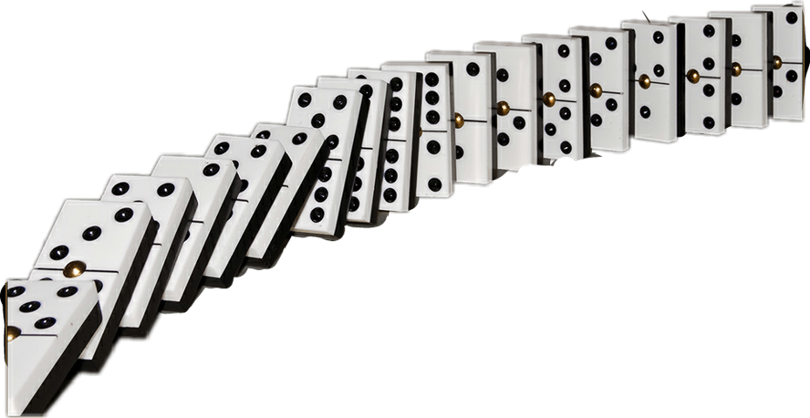
Arrays

Slide 11
Arrays
They are objects to a very limited extent.
There is no keyword with which all arrays are declared.
They may be considered instances of an understood array class.

Slide 12
Arrays
How to declare
int[] a;
int a[];
int[] a = new int[10];
int[] b = {5, 4, 2, 1};

Slide 13
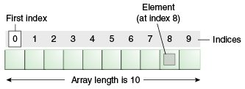
Arrays
How to access elements

Slide 14
Arrays
LIMITATION
Changing the size of the array is expensive
Create a new array
Copying all data from the array with the old size to the array with the new size.

Slide 15
Arrays
LIMITATION
OTHER LIMITATION
Changing the size of the array is expensive
Create a new array
Copying all data from the array with the old size to the array with the new size.
The data in the array are next to each other sequentially in memory
Inserting an item inside the array requires shifting some other data in this array.

Slide 16

Matrix

Slide 17
Matrix
A matrix can be thought as a two-dimensional array or an array of arrays
int [][] nums = new int[5][4];

Slide 18
Matrix
A matrix can be thought as a two-dimensional array or an array of arrays
int [][] nums = new int[5][4];
Rows

Slide 19
Matrix
A matrix can be thought as a two-dimensional array or an array of arrays
int [][] nums = new int[5][4];
Rows
Columns

Slide 20

Linked Lists

Slide 21
Linked List
A linear data structure where each element (node) is a separate object and not necessarily adjacent in memory.
A dynamic data structure.
The number of nodes is not fixed.
A list can grow and shrink on demand.
Any application which has to deal with an unknown number of objects will need to use a linked list.

Slide 22
Linked List
A node contains a data field that is a reference to another node. This is how the nodes are linked.
So each node holds is composed of data and a reference to another node in the list.
The last node of the list “points” to null in the node reference field.

Slide 23
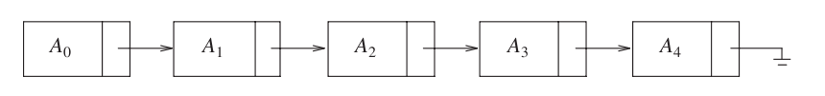
Linked List
A node contains a data field that is a reference to another node. This is how the nodes are linked.
So each node holds is composed of data and a reference to another node in the list.
The last node of the list “points” to null in the node reference field.

Slide 24
Linked List
A node contains a data field that is a reference to another node. This is how the nodes are linked.
So each node holds is composed of data and a reference to another node in the list.
The last node of the list “points” to null in the node reference field.
Always do the drawing!

Slide 25
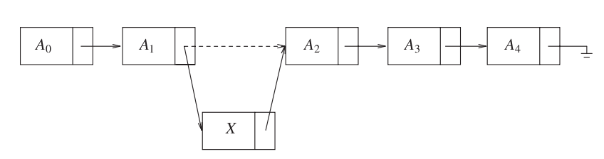
Linked List
Inserting an element to a list

Slide 26
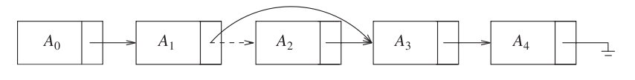
Linked List
Deleting an element from a list

Slide 27
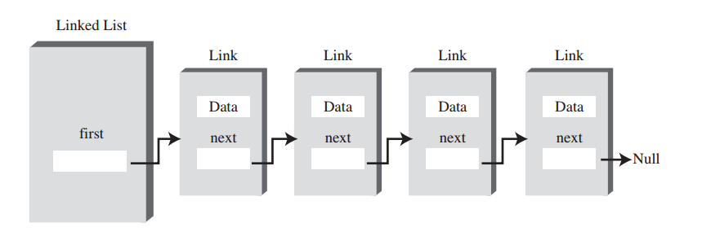
Linked List

Slide 28
Linked List
Implementing a linked list
There is more than one specific way to implement a linked list.
Just like most things in computing, there is more than one way of solving problems.

Slide 29
Linked List
Implementing a linked list
01 02 03 04 05 06 07 08 09 10 11 12 13 14 15 16 | class Node { private Object data; private Node next; public Node(Object data) { this.next = null; this.data = data; } public Object getData() { return this.data; } public void setData(Object data) { this.data = data; }

Slide 30
Linked List
Implementing a linked list
01 02 03 04 05 06 07 08 09 10 11 12 13 14 15 16 | public Node getNext() { return this.next; } public void setNext(Node node) { this.next = node; } }

Slide 31
Linked List
Implementing a linked list
01 02 03 04 05 06 07 08 09 10 11 12 13 14 15 16 | class LinkedList { private Node head; private int size; public LinkedList() { this.head = null; this.size = 0; } public boolean isEmpty() { return this.head == null; } public int size() { return this.size; }

Slide 32
Linked List
Implementing a linked list
01 02 03 04 05 06 07 08 09 10 11 12 13 14 15 16 17 | public void insertFirst(Object data) { Node newNode = new Node(data); newNode.next = this.head; this.head = newNode; this.size++; } public Node deleteFirst() { if (this.head != null) { Node temp = this.head; this.head = this.head.next; this.size--; return temp; } else { return null; } }

Slide 33
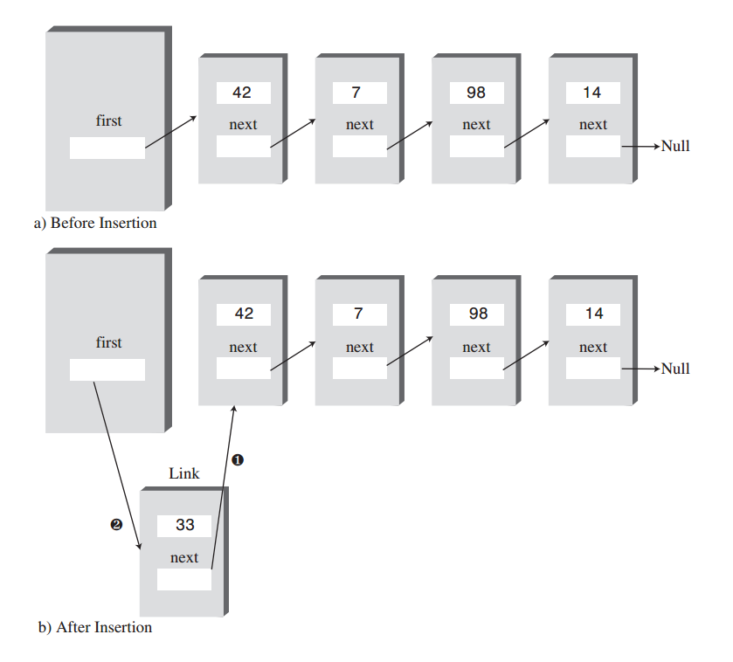
Linked List
Implementing a linked list

Slide 34
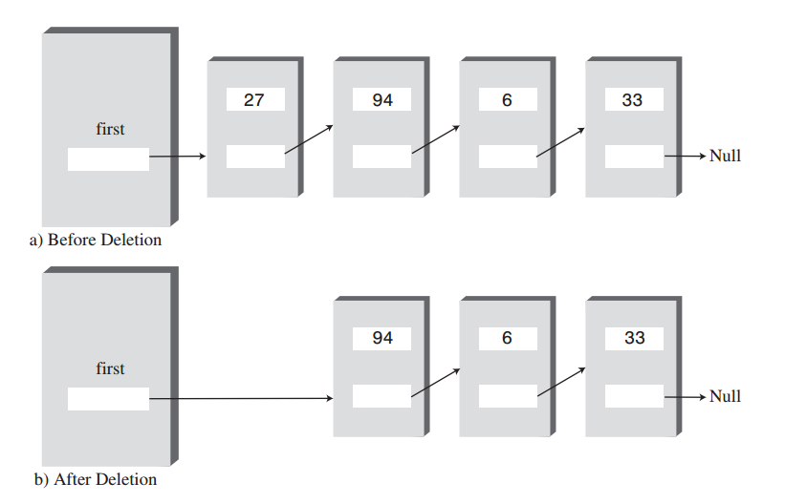
Linked List
Implementing a linked list

Slide 35
Linked List
Implementing a linked list
01 02 03 04 05 06 07 08 09 10 11 12 13 14 15 16 | public void displayList() { Node current = this.head; while (current != null) { System.out.println(current.getData()); current = current.getNext(); } }

Slide 36
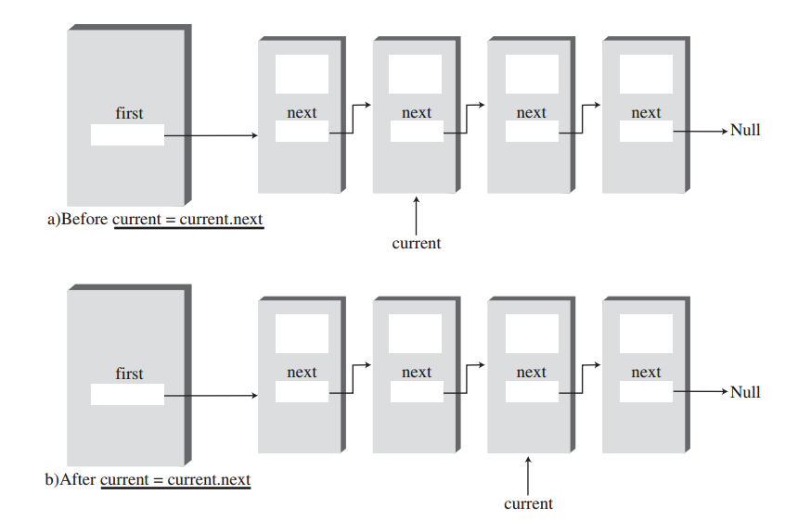
Linked List
Implementing a linked list

Slide 37
Linked List
Implementing a linked list
01 02 03 04 05 06 07 08 09 10 11 12 13 14 15 16 | public Node find(Object searchValue) { Node current = this.head; while (current != null) { if (current.getData().equals(searchValue)) { return current; } else { current = current.getNext(); } } return null; }

Slide 38
Linked List
Implementing a linked list
01 02 03 04 05 06 07 08 09 10 11 12 13 14 15 16 17 18 19 | public Node delete(Object searchValue) { Node current = this.head; Node previous = this.head; while (current != null) { if (current.getData().equals(searchValue)) { if (current == this.head) { this.head = this.head.getNext(); } else { previous.setNext(current.getNext()); } return current; } else { previous = current; current = current.getNext(); } } return null; }

Slide 39
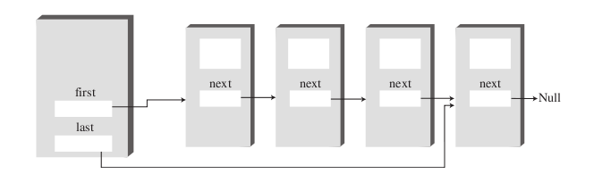
Linked List
Implementing a linked list
To increase performance, specially when inserting at the end, you can add a reference to the last node (double-ended list).

Slide 40
Linked List
Implementing a linked list
01 02 03 04 05 06 07 08 09 10 11 12 13 14 15 16 17 18 | class DoubleEndedList { private Node head; private Node last; private int size; public LinkedList() { this.head = null; this.last = null; this.size = 0; } public boolean isEmpty() { return this.head == this.last == null; } public int size() { return this.size; }

Slide 41
Linked List
Implementing a linked list
01 02 03 04 05 06 07 08 09 10 11 12 13 14 15 16 17 18 | public void insertFirst(Object data) { Node newNode = new Node(data); if (this.isEmpty()) { this.head = this.last = newNode; } else { newNode.setNext(this.head); this.head = newNode; } this.size++; }

Slide 42
Linked List
Implementing a linked list
01 02 03 04 05 06 07 08 09 10 11 12 13 14 15 16 17 18 | public void insertLast(Object data) { Node newNode = new Node(data); if (this.isEmpty()) { this.head = this.last = newNode; } else { this.last.setNext(newNode); this.last = newNode; } this.size++; }

Slide 43

Doubly Linked Lists

Slide 44
Doubly Linked Lists
Is a variation of the simple list.
The advantage is that ease backward navigation of the list.
Each node has two references to other nodes instead of one. The first is a link to the next node, like a simple list. The second is the previous node.

Slide 45
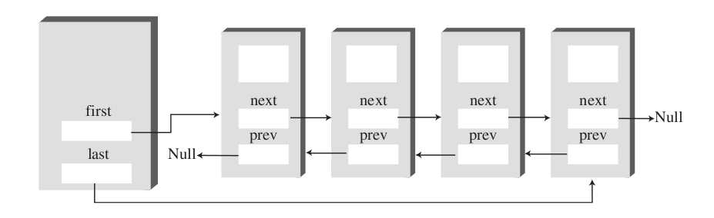
Doubly Linked Lists

Slide 46
Doubly Linked Lists
The downside of doubly linked list is dealing with more links while inserting / deleting nodes.
Nodes are little bigger because they have an extra link

Slide 47
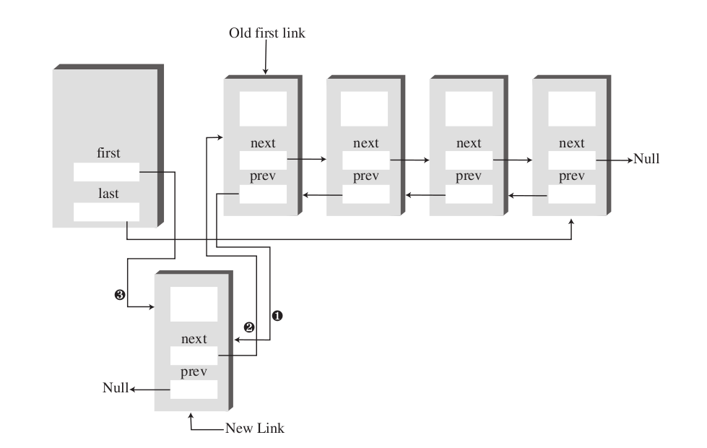
Doubly Linked Lists
Insert at the beginning

Slide 48
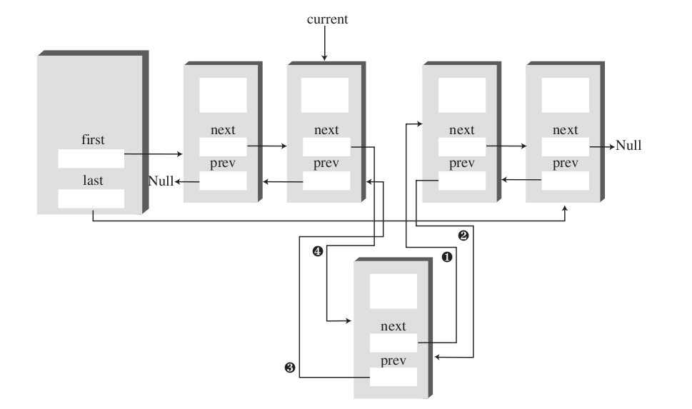
Doubly Linked Lists
Insert at an arbitrary position

Slide 49
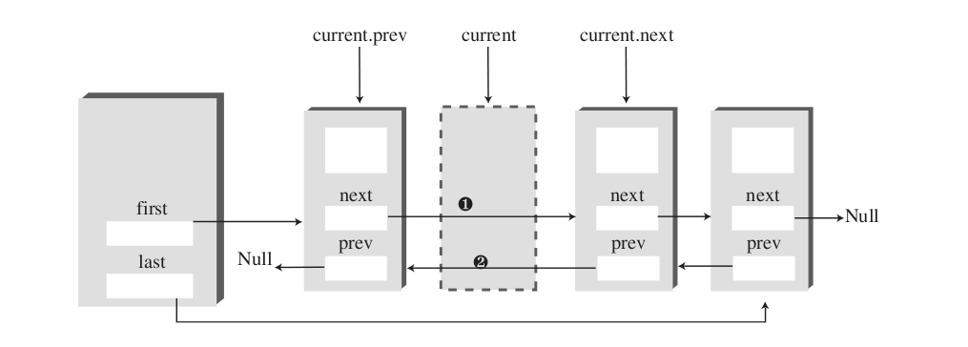
Doubly Linked Lists
Delete at an arbitrary position

Slide 50
Doubly Linked Lists
Delete at an arbitrary position

Slide 51

Circular List

Slide 52
Circular Lists
Lists viewed so far have a linear nature: each node has a predecessor and each node has a unique successor.
If we change the last node next reference to point to the head node, we will have a circular list.
We can traverse the whole list starting from any node.
A circular list is a list in which every node has a successor and the “last” element is succeeded by the “first” element.

Slide 53
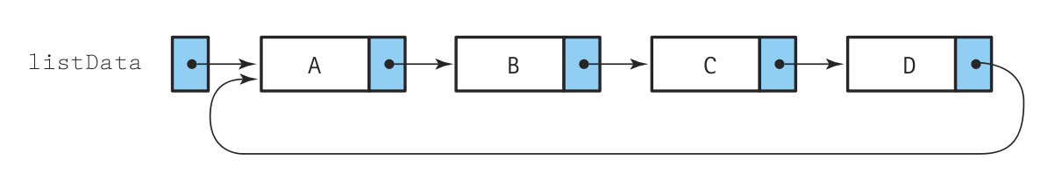
Circular Lists
Lists viewed so far have a linear nature: each node has a predecessor and each node has a unique successor.
If we change the last node next reference to point to the head node, we will have a circular list.
We can traverse the whole list starting from any node.
A circular list is a list in which every node has a successor and the “last” element is succeeded by the “first” element.

Slide 54
Circular Lists
Lists viewed so far have a linear nature: each node has a predecessor and each node has a unique successor.
If we change the last node next reference to point to the head node, we will have a circular list.
We can traverse the whole list starting from any node.
A circular list is a list in which every node has a successor and the “last” element is succeeded by the “first” element.
What problems can arise with having the head to the first node?
Deleting the first node, means traversing the whole list to update the last...

Slide 55
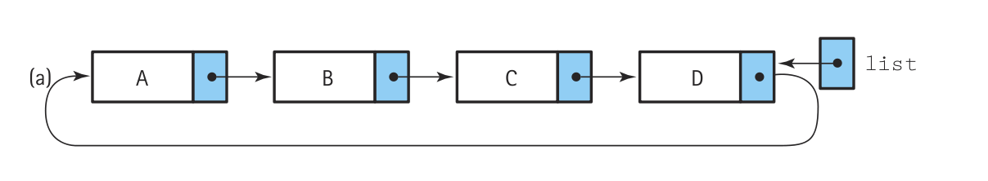
Circular Lists

Slide 56
Circular Lists
Keeping the reference to the last element, allows to access the last and first faster

Slide 57
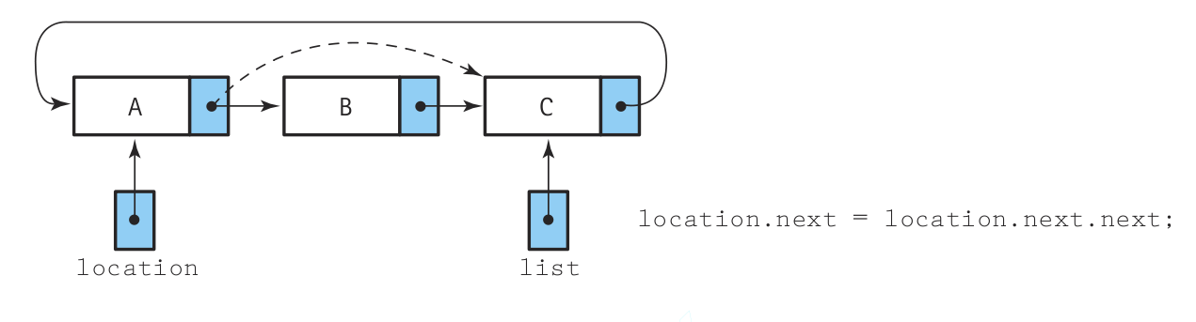
Circular Lists
Deleting

Slide 58
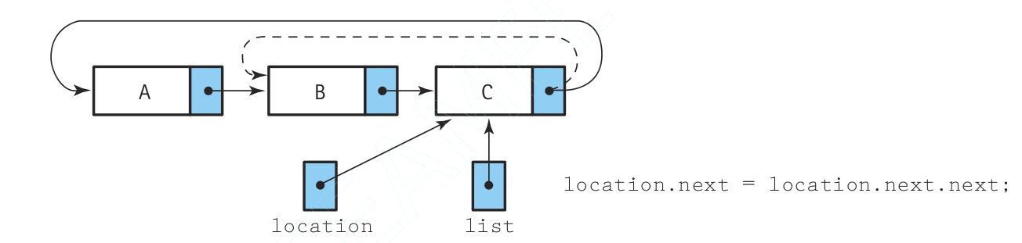
Circular Lists
Deleting

Slide 59
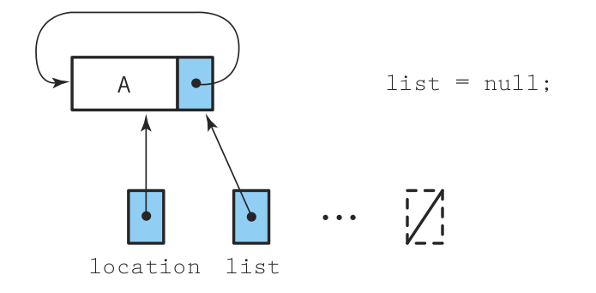
Circular Lists
Deleting

Slide 60
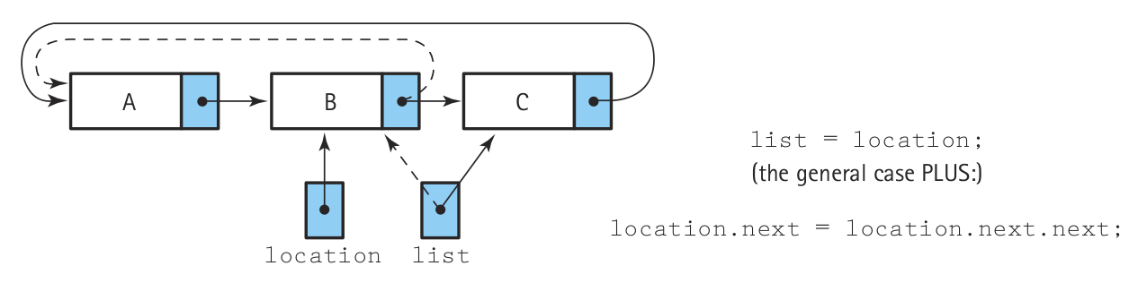
Circular Lists
Deleting

Slide 61
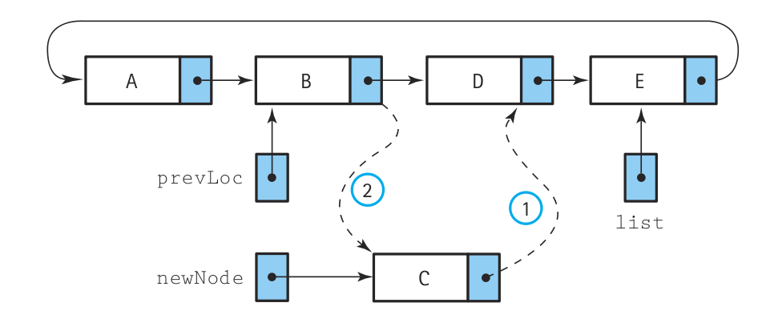
Circular Lists
Inserting

Slide 62
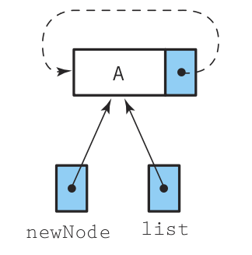
Circular Lists
Inserting

Slide 63
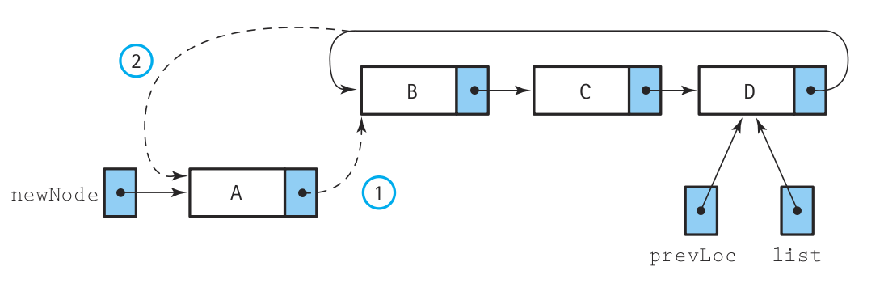
Circular Lists
Inserting

Slide 64
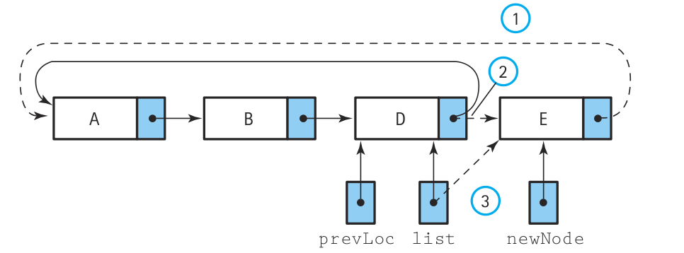
Circular Lists
Inserting

Slide 65
Circular Lists
When to use a circular list
Good for applications that needs to access both ends of the list.
If the list is ordered, is easier to find the largest element and doing operations like inBetween().
Can be more efficient for some specific tasks.

Slide 66

Stack

Slide 67
Stack
A stack allows access to only one data item: the last item inserted.
If you remove this item, you can access the next-to-last element inserted, and so on.
LIFO (Last In, First Out) nature.

Slide 68
Stack
Stacks play vital role in many situations.
Processors use stacks intensively.
Compilers use stacks to interpret the programming language expressions.
Many algorithms need to use stacks.

Slide 69
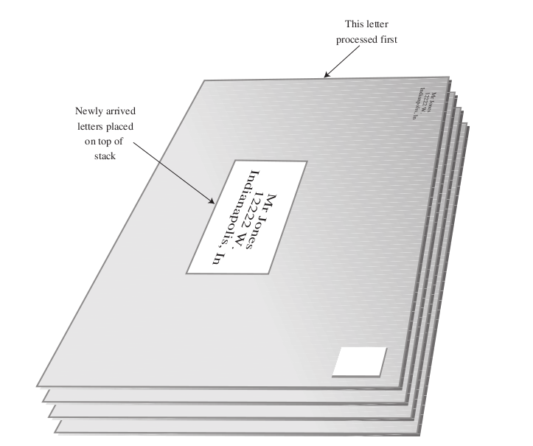
Stack

Slide 70
Stack
Stack have three main operations:
Pop: removes the element on the top of the stack.
Push: adds a new element on the top of the stack.
Peek: gets the element on the top without removing it.
There is no other way to traverse the stack, only through push and pop operations.

Slide 71
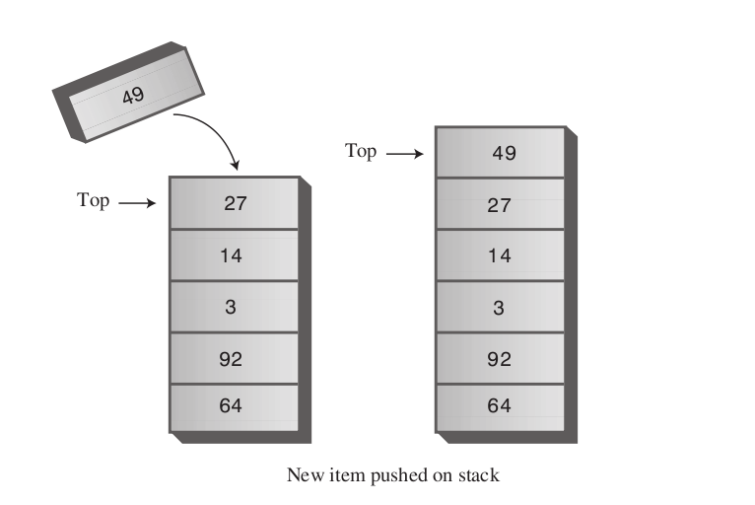
Stack

Slide 72
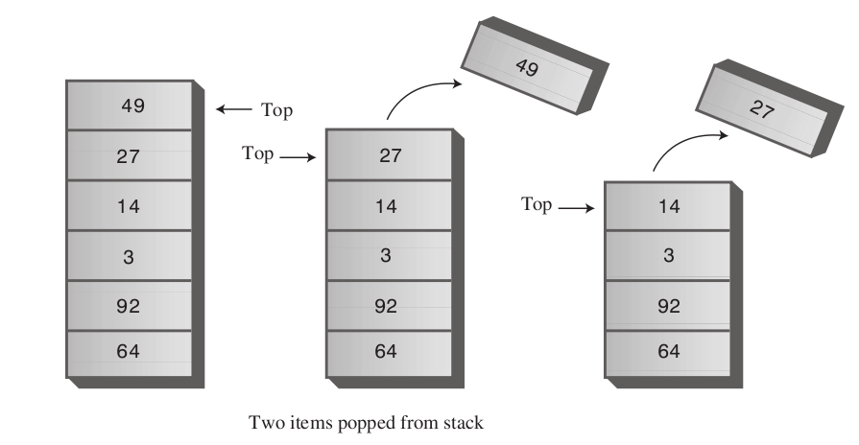
Stack

Slide 73
Stack
Using arrays
01 02 03 04 05 06 07 08 09 10 11 12 13 14 15 16 17 18 19 | class Stack { private int maxSize; private Object[] stackArray; private int top; ... public void push(Object newObject) { if (top < maxSize) { this.stackArray[++top] = newObject; } else { throw new Exception("Stack is full"); } } public Object pop() { return this.stackArray[top--]; } ...

Slide 74
Stack
Using arrays
01 02 03 04 05 06 07 08 09 10 11 12 13 14 15 16 17 18 19 | public Object peek() { return this.stackArray[top]; }

Slide 75
Stack
Using linked lists
01 02 03 04 05 06 07 08 09 10 11 12 13 14 15 16 17 18 19 | class Stack { private LinkedList stackList; ... public void push(Object newElement) { this.stackList.insertFirst(newElement); } public Object pop() { return this.stackList.deleteFirst(); } public Object peek() { return this.stackList.getHead(); } }

Slide 76

Queues

Slide 77
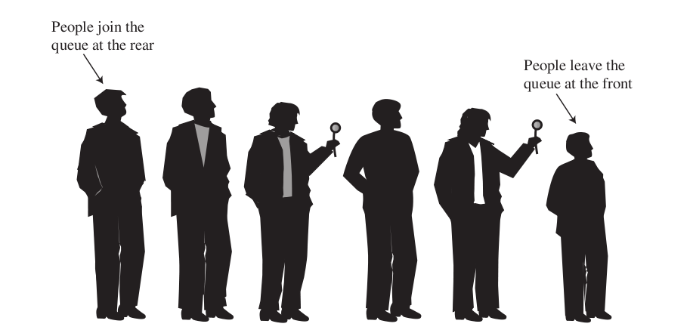
Queue
Similar to a stack but follows a FIFO (First In, First Out) nature.

Slide 78
Queue
Used to abstract many real life situation.
Internally, the Operating System uses queues intensively (printing queues, keyboard input, so on).
Queue support three main operations:
Enqueue: add an element to the rear of the queue.
Dequeue: remove an element from the front.
Peek: get the element in front without removing it.

Slide 79
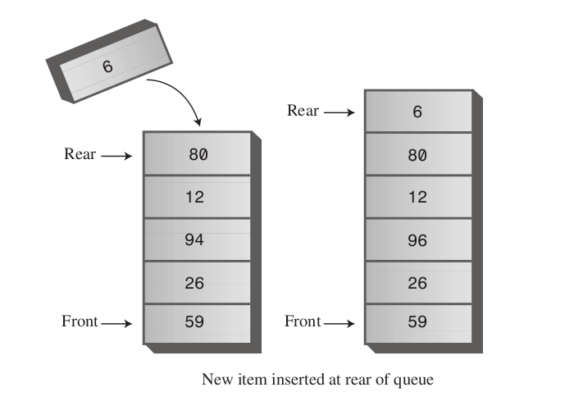
Queue

Slide 80
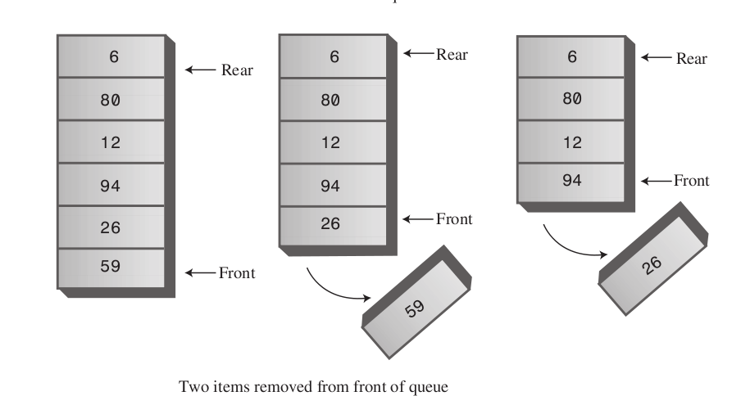
Queue

Slide 81
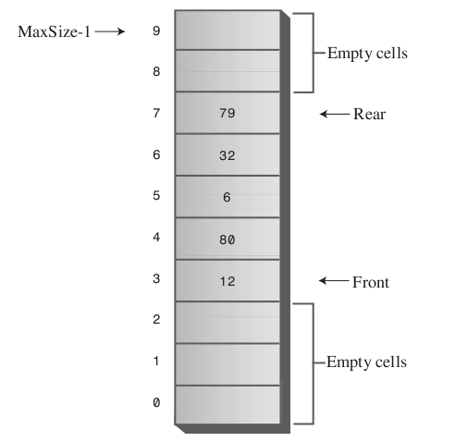
Queue
If the queue is implemented using an array, we can end up having the following situation:

Slide 82
Queue
One way to avoid this is moving the whole array after each dequeue operation.
A prefered way is using a wrapping technique.

Slide 83
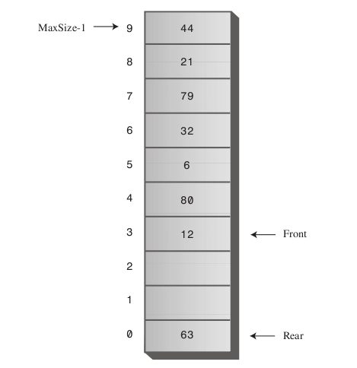
Queue

Slide 84
Queue
Also called a broken sequence

Slide 85
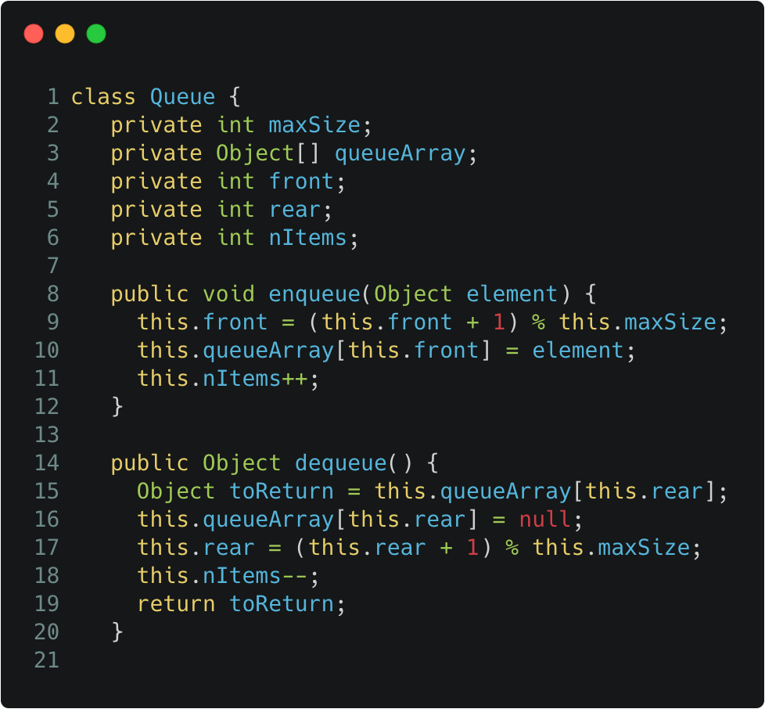
Queue
Using arrays
class Queue { private int maxSize; private Object[] queueArray; private int front; private int rear; private int nItems; ... public void enqueue(Object element) { this.front = (this.front + 1) % this.maxSize; this.queueArray[this.front] = element; this.nItems++; } public Object dequeue() { Object toReturn = this.queueArray[this.rear]; this.queueArray[this.rear] = null; this.rear = (this.rear + 1) % this.maxSize; this.nItems--; return toReturn; }

Slide 86
Queue
Using linked lists
01 02 03 04 05 06 07 08 09 10 11 12 13 14 15 16 17 18 19 | class Queue { private DoubleEndedList list; ... public void enqueue(Object element) { this.list.insertLast(element); } public Object dequeue() { return this.list.removeFirst(); }

Slide 87
Priority Queue
CHARACTERISTICS
Is a more specialized Data Structure than a queue or a stack.
It is an useful tool in a surprising number of situations.
Like a normal queue, it has a front and a rear. Items are removed from the front.

Slide 88
Priority Queue
CHARACTERISTICS
OTHER CHARACTERISTICS
Is a more specialized Data Structure than a queue or a stack.
It is an useful tool in a surprising number of situations.
Like a normal queue, it has a front and a rear. Items are removed from the front.
Enqueuing an item is different. Items are ordered by a key.
An item with the lowest key is always at the front. Items are inserted in the proper position to maintain order.

Slide 89
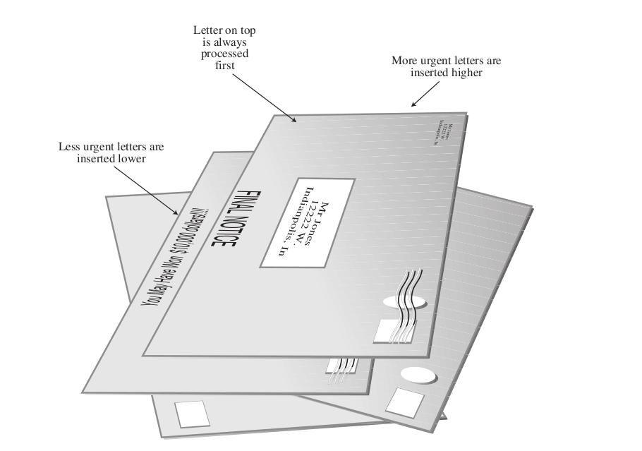
Priority Queue

Slide 90
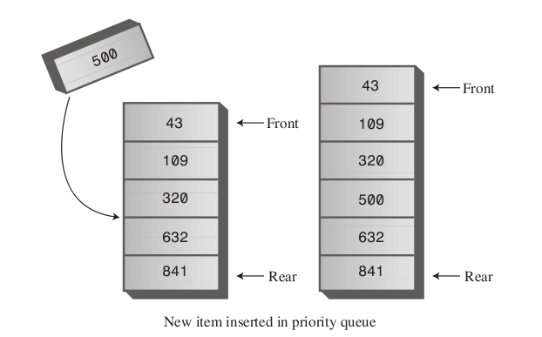
Priority Queue
Enqueuing a new element

Slide 91
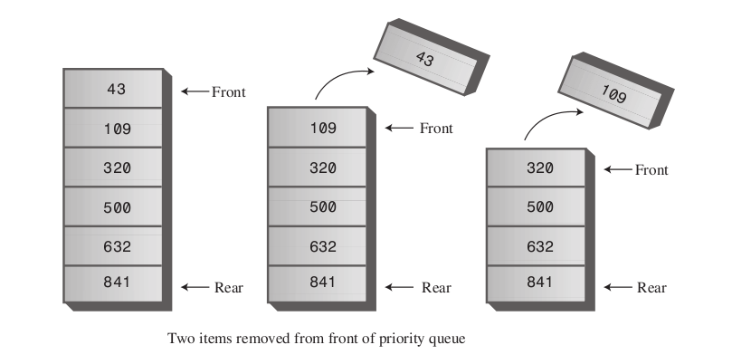
Priority Queue
Dequeuing a new element

Slide 92
Linear Data Structures
CE1103 - Algorithms and Data Structures I

